Slide 1
Digital Computer Design
Datapath

Slide 2
Overview of a digital system
Consist of two main subsystems
Datapath
Control unit

Slide 3
Overview of a digital system
The datapath is responsible for the actual execution of all operations performed by the digital system
such as the addition inside the arithmetic logic unit (ALU).
The datapath also includes the registers
for the temporary storage of your data

Slide 4
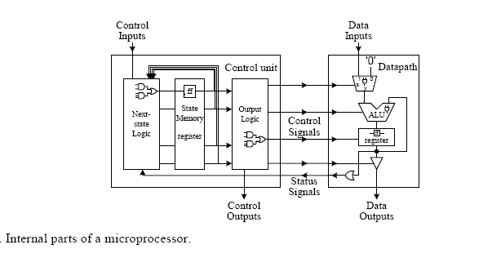
Overview of a digital system

Slide 5
DATAPATH

Slide 6
The datapath is responsible for the manipulation of data. It includes:
functional units such as adders, shifters, multipliers, ALUs, and comparators
registers and other memory elements for the temporary storage of data
buses and multiplexers for the transfer of data between the different components in the datapath

Slide 7
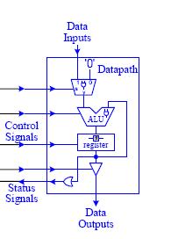

Slide 8
Datapath design is also referred to as the register-transfer level (RTL) design
In the register-transfer level design, we look at how data is transferred from one register to another or back to the same register
In the design of datapaths, two methods are used:
Using General Datapaths or Dedicated Datapaths

Slide 9
Dedicated Datapath

Slide 10
Datapath for both operations

Slide 11
Both operations with a common adder

Slide 12
Summation of n to 1

Slide 13
Datapath of the Summer

Slide 14
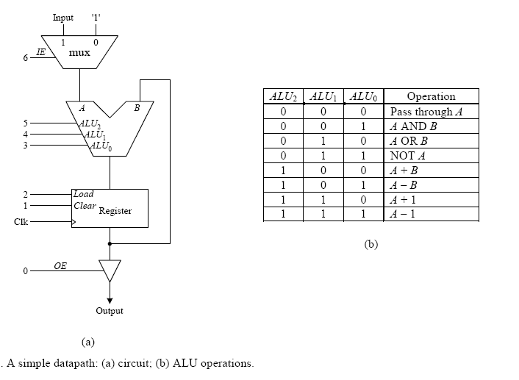
General Datapath

Slide 15
There are seven control lines (number 0 to 6) for controlling the operations of this simple datapath
Various operations can be performed by this simple datapath by asserting or de-asserting these control signals at different times.
These control lines are grouped together to form what is called a control word
One operation of the datapath, therefore, is determined by the values set in one control word, and will take one clock cycle to perform

Slide 16
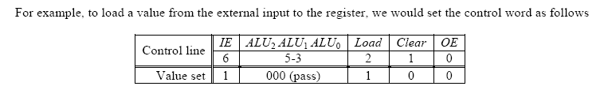
Example

Slide 17
Using General datapaths

Slide 18
The General Datapath with Status

Slide 19
Simulation Trace

Slide 20
Summing numbers from n to 1

Slide 21
Complex general datapath with a register file

Slide 22
Control words

Slide 23
Simulation trace

Slide 24
Revision to do
Sequential circuit with emphasis on state diagrams and FSMs

